Slide 1


Unit-03 Inheritance and Abstraction
Object Oriented Programming (OOP)
(2301CS201)
Prof. Arjun V. Bala
Computer Engineering Department
arjun.bala@darshan.ac.in
9624822202

Slide 2

Outline
Inheritance
Types of inheritance
Overriding
Super keyword
Final keyword
Finalize method
Dynamic Method Dispatch
Abstract class
Interface
Looping

Slide 3
Inheritance
The mechanism of deriving a new class from an old class is called inheritance or derivation.
The old class is known as base class while new class is known as derived class or subclass.
It lets programmers create new classes that share some of the attributes of existing classes.
Inheritance lets us build on previous work without reinventing the wheel.
The inheritance is the most powerful feature of OOP.
Through effective use of inheritance, we can save lot of time in programming and also reduce errors, which in turn will increase the quality of work and productivity.
Employee
Manager
Worker
- ID
- Name
- Address
- Contact
- ID
- Name
- Address
- Contact
- MonthlySalary
- ID
- Name
- Address
- Contact
- DailySalary
- NoOfHours

Slide 4
Inheritance using extends keyword
When a Class extends another class it inherits all non-private members including fields and methods.
Inheritance in Java can be best understood in terms of Parent and Child relationship, also known as Super class(Parent) and Sub class(Child).
Inheritance defines IS-A relationship between a Super class and its Sub class.
For Example :
Car IS A Vehicle
Bike IS A Vehicle
EngineeringCollege IS A College
MedicalCollege IS A College
MCACollege IS A College
extends is the keyword used to implement inheritance.

Slide 5
extends (Cont.)
Syntax :
Vehicle
noOfPassanger
maxSpeed
noOfWheels
noOfGears
noOfPassanger
maxSpeed
noOfWheels
noOfGears
noOfPassanger
maxSpeed
noOfWheels
noOfGears
noOfPassanger
maxSpeed
noOfWheels
noOfGears
class A {
// code
}
class B extends A{
// code
}
extends
extends
extends
Example:
Bike
cubicCapacity
isMoped
Bike
cubicCapacity
isMoped
Car
horsePower
noOfAirBags
tollTaxAmount()
Car
horsePower
noOfAirBags
tollTaxAmount()
Truck
horsePower
loadingCapacity
payTollTax()
Truck
horsePower
loadingCapacity
payTollTax()
class Vehicle {
. . . . . .
}
class Bike extends Vehicle{
. . . . . .
}
class Car extends Vehicle{
. . . . . .
}

Slide 6
Example (Inheritance)
class Vehicle {
int noOfPassanger;
int maxSpeed;
public void display() {
System.out.println("Passangers = " + noOfPassanger);
System.out.println("Max Speed = " + maxSpeed);
}
}
class Car extends Vehicle {
double horsePower;
int noOfAirbags;
public void display() {
System.out.println("Passangers = " + noOfPassanger);
System.out.println("Max Speed = " + maxSpeed);
System.out.println("Hourse Power = " + horsePower);
System.out.println("Airbags = " + noOfAirbags);
}
}

Slide 7
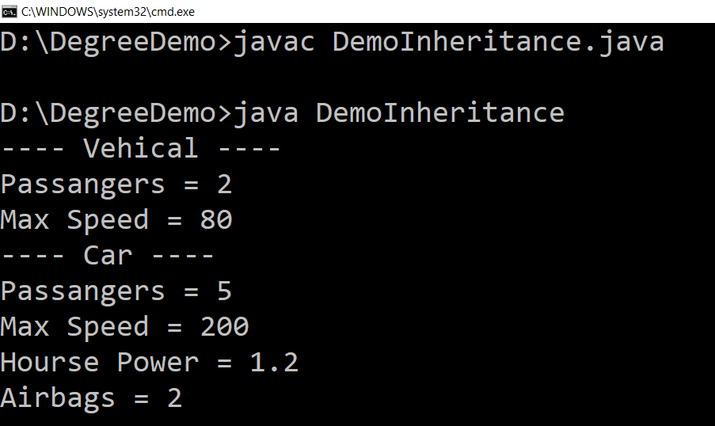
Example (Inheritance) (Cont.)
public class DemoInheritance {
public static void main(String ar[]) {
Vehicle v = new Vehicle();
v.maxSpeed = 80;
v.noOfPassanger = 2;
System.out.println("---- Vehicle ----");
v.display();
Car c = new Car();
c.maxSpeed = 200;
c.noOfPassanger = 5;
c.horsePower = 1.2;
c.noOfAirbags = 2;
System.out.println("---- Car ----");
c.display();
}
}

Slide 8
Types of Inheritance in Java
1. Single Inheritance
2. Hierarchical Inheritance
3. Multilevel Inheritance
A
A
A
B
B
C
B
C
4. Multiple Inheritance
5. Hybrid Inheritance
A
B
A
Note: Multiple and Hybrid Inheritance is not supported in Java with the Class Inheritance, we can still use those Inheritance with Interface which we will learn in later part of the Unit
C
B
C
D

Slide 9
Inheritance (Cont.)
Each Java class has one (and only one) superclass.
C++ allows multiple inheritance
BUT
Java does not support multiple inheritance
There is no limit to the number of subclasses a class can have
Inheritance creates a class hierarchy
Classes higher in the hierarchy are more
general and more abstract
Classes lower in the hierarchy are more
specific and concrete
There is no limit to the depth of the class tree.
Class
Class
Class
Class
Class
Class
Class
Class
Class
Class
Class

Slide 10
Object class
Object class is super class of all the classes.
The Object class is defined in the java.lang package
Object
….
….
….
….
….
….
….
….
….
….
….
….
….

Slide 11
Constructors in Inheritance
Classes use constructors to initialize instance variables
When a subclass object is created, its constructor is called after the superclass default constructor.
It is the responsibility of the subclass constructor to invoke the appropriate superclass constructors so that the instance variables defined in the superclass are properly initialized
Superclass constructors can be called using the "super" keyword in a manner similar to "this"
It must be the first line of code in the constructor
If a call to super is not made, the system will automatically invoke the no-argument constructor of the superclass.

Slide 12
super keyword
The super keyword in Java is a reference variable which is used to refer immediate parent class object.
The most common use of the super keyword is to eliminate the confusion between superclasses and subclasses that have methods with the same name.
Usage of Java super Keyword
super can be used to refer immediate parent class instance variable.
super can be used to invoke immediate parent class method.
super() can be used to invoke immediate parent class constructor.

Slide 13
Overriding methods
Subclasses inherit all methods from their superclass
Sometimes, the implementation of the method in the superclass does not provide the functionality required by the subclass.
In these cases, the method must be overridden.
Rules for Method overriding
Method signature must be same as of Super Class method.
The return type should be the same.
The access level cannot be more restrictive than the overridden method's access level.
Example :
protected -> public // is allowed
protected -> private // is not allowed

Slide 14
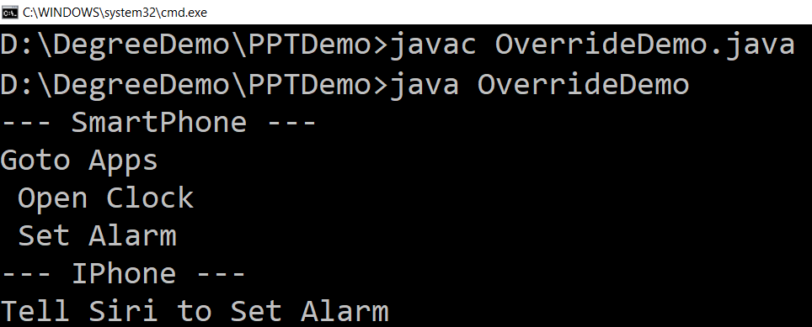
Overriding (Example)
class SmartPhone{
public void setAlarm(){
System.out.println
("Goto Apps\n
Open Clock\n
Set Alarm");
}
}
class IPhone extends SmartPhone
{
public void setAlarm()
{
System.out.println
("Tell Siri to Set Alarm");
}
}
public class OverrideDemo {
public static void main(String[] ar) {
SmartPhone s = new SmartPhone();
System.out.println("--- SmartPhone ---");
s.setAlarm();
IPhone i = new IPhone();
System.out.println("--- IPhone ---");
i.setAlarm();
}
}

Slide 15
“final” keyword
The final keyword is used for restriction.
final keyword can be used in many context
Final can be:
Variable
If you make any variable as final, you cannot change the value of final variable(It will be constant).
Method
If you make any method as final, you cannot override it.
Class
If you make any class as final, you cannot extend it.

Slide 16
1) “final” as a variable
Can not change the value of final variable.
public class FinalDemo {
final int speedlimit=90;//final variable
void run(){
speedlimit=400;
}
public static void main(String args[]){
FinalDemo obj=new FinalDemo();
obj.run();
}
}
final

Slide 17
2) “final” as a method
If you make any method as final, you cannot override it.
class BikeClass{
final void run(){
System.out.println("Running Bike");
}
}
class Pulsar extends BikeClass{
void run(){
System.out.println("Running Pulsar");
}
public static void main(String args[]){
Pulsar p= new Pulsar();
p.run();
}
}
final

Slide 18
3) “final” as a Class
If you make any class as final, you cannot extend it.
final
final class BikeClass{
void run(){
System.out.println("Running Bike");
}
}
class Pulsar extends BikeClass
{
void run(){
System.out.println("Running Pulsar");
}
public static void main(String args[]){
Pulsar p= new Pulsar();
p.run();
}
}

Slide 19
Dynamic Method Dispatch
Method overriding is one of the ways in which Java supports Runtime Polymorphism.
Dynamic method dispatch is the mechanism by which a call to an overridden method is resolved at run time, rather than compile time.
A superclass reference variable can refer to a subclass object, This is also known as upcasting.
Static v/s Dynamic Binding
Static Binding | Dynamic Binding
Occurs during compile time | Occurs during runtime
It uses type(Class) information for binding | It uses instance of class(Object) to resolve calling of method
Overloaded methods are bonded using static binding | Overridden methods are bonded using dynamic binding
Static binding means when the type of object which is invoking the method is determined at compile time by the compiler | Dynamic binding means when the type of object which is invoking the method is determined at run time by the compiler

Slide 20
Dynamic Method Dispatch (Example)
class Game {
public void type() {
System.out.println("Indoor & outdoor");
}
}
class Cricket extends Game {
public void type() {
System.out.println("outdoor game");
}
}
class Badminton extends Game {
public void type() {
System.out.println("indoor game");
}
}
class Tennis extends Game {
public void type() {
System.out.println("Mix game");
}
}
public class MyProg {
public static void main(String[] args) {
Game g = new Game();
Cricket c = new Cricket();
Badminton b = new Badminton();
Tennis t = new Tennis();
Scanner s = new Scanner(System.in);
System.out.print("Please Enter name \n
of the game = ");
String op = s.nextLine();
if (op.equals("cricket")) {
g = c;
} else if (op.equals("badminton")) {
g = b;
} else if (op.equals("tennis")) {
g = t;
}
g.type();
}
}

Slide 21
instanceof operator
instanceof Operator
Syntax:
( Object reference variable ) instanceof (class/interface type)
Example:
boolean result = name instanceof String;

Slide 22
Abstract class
Abstraction is a process of hiding the implementation details from the user, only the functionality will be provided to the user.
In other words, the user will have the information on what the object does instead of how it does it.
Abstraction is achieved using Abstract classes and interfaces.
A class which contains the abstract keyword in its declaration is known as abstract class.
Abstract classes may or may not contain abstract methods, i.e., methods without body ( public void get(); )
But, if a class has at least one abstract method, then the class must be declared abstract.
If a class is declared abstract, it cannot be instantiated.
To use an abstract class, you have to inherit it to another class and provide implementations of the abstract methods in it.

Slide 23
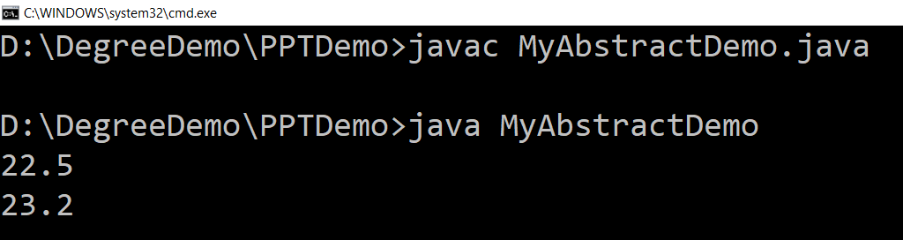
Abstract class (Example)
abstract class Car {
public abstract double getAverage();
}
class Swift extends Car{
public double getAverage(){
return 22.5;
}
}
class Baleno extends Car{
public double getAverage(){
return 23.2;
}
}
public class MyAbstractDemo{
public static void main(String ar[]){
Swift b1 = new Swift();
Baleno b2 = new Baleno();
System.out.println(b1.getAverage());
System.out.println(b2.getAverage());
}
}

Slide 24
Interface
An interface is similar to an abstract class with the following exceptions
All methods defined in an interface are abstract. Interfaces can contain no implementation
Interfaces cannot contain instance variables. However, they can contain public static final variables (ie. constant class variables)
Interfaces are declared using the "interface" keyword
If an interface is public, it must be contained in a file which has the same name
Interfaces are more abstract than abstract classes
Interfaces are implemented by classes using the "implements" keyword

Slide 25
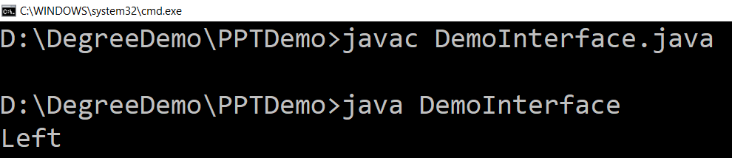
Interface (Example)
interface VehicalInterface {
int a = 10;
public void turnLeft();
public void turnRight();
public void accelerate();
public void slowDown();
}
class CarClass implements VehicalInterface
{
public void turnLeft() {
System.out.println("Left");
}
public void turnRight() {
System.out.println("Right");
}
public void accelerate() {
System.out.println("Speed");
}
public void slowDown() {
System.out.println("Break");
}
}
Here access specifier of method must be public
public class DemoInterface{
public static void main(String[] a)
{
CarClass c = new CarClass();
c.turnLeft();
}
}
Variable in interface are by default
public, static, final
We have to provide implementation to all the methods of the interface

Slide 26
Interface V/S Abstract Class
Interface | Abstract Class
Interface support multiple inheritance | Abstract class does not support multiple inheritance
Interface does not contains Constructor | Abstract class contains Constructor
An interface contains only incomplete /abstract methods | An abstract class contains both incomplete and complete methods
An interface cannot have access modifiers, so by default everything is public. | An abstract class can contain access modifiers for the functions, properties
Methods of interface cannot be static | Only complete Methods of abstract class can be static
Variables declared in interface are public, static, final by default. | An abstract class may contain non-final variables.
Interface should be implemented using keyword “implements”. | Abstract class should be extended using keyword “extends”.

Slide 27
Lab Programs
The abstract Vegetable class has three subclasses named Potato, Brinjal and Tomato. Write a java prog. That demonstrates how to establish this class hierarchy. Declare one instance variable of type String that indicates the color of a vegetable. Crete and display instances of these objects. Override the toString() method of object to return a string with the name of vegetable and its color.
Declare a class called Book having book title & author name as members. Create a sub-class of it, called BookDetails having price & current stock of book as members. Create an array for storing details of n books. Define methods to achieve following:
- Initialization of members
- To query availability of a book by author name / book title
- To update stock of a book on purchase and sell
- Define method main to show usage of above methods.

